Slide 1
Agenda
Azure Kubernetes Service
What is Azure Kubernetes Service (AKS)
AKS Benefits and Use Cases
Accessing AKS Cluster
AKS Deployment Using CLI
Accessing AKS Application
Azure DevOps CI/CD Pipeline with AKS

Slide 2
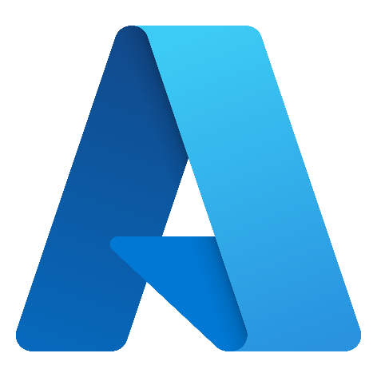
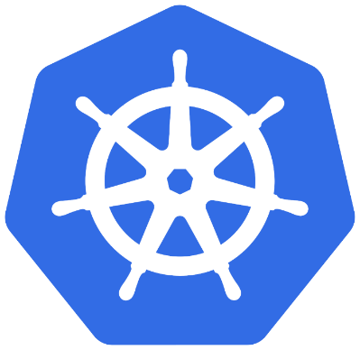
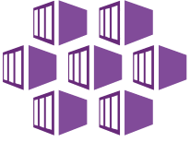
Azure Kubernetes Service (AKS)

Slide 3
Azure Kubernetes Service Benefits
A fully-managed Kubernetes service
Offers serverless Kubernetes, an integrated continuous integration and continuous delivery (CI/CD) experience
Offers enterprise-grade security and governance.
Paying for only the virtual machines and associated storage and networking resources.
There is no charge for cluster management.
Notes:
https://azure.microsoft.com/en-in/services/kubernetes-service/#solution-architectures
https://docs.microsoft.com/en-us/azure/aks/concepts-clusters-workloads
https://docs.microsoft.com/en-us/azure/aks/concepts-network
Nodes of the same configuration are grouped together into node pools. A Kubernetes cluster contains one or more node pools. The initial number of nodes and size are defined when you create an AKS cluster, which creates a default node pool. This default node pool in AKS contains the underlying VMs that run your agent nodes.

Slide 4
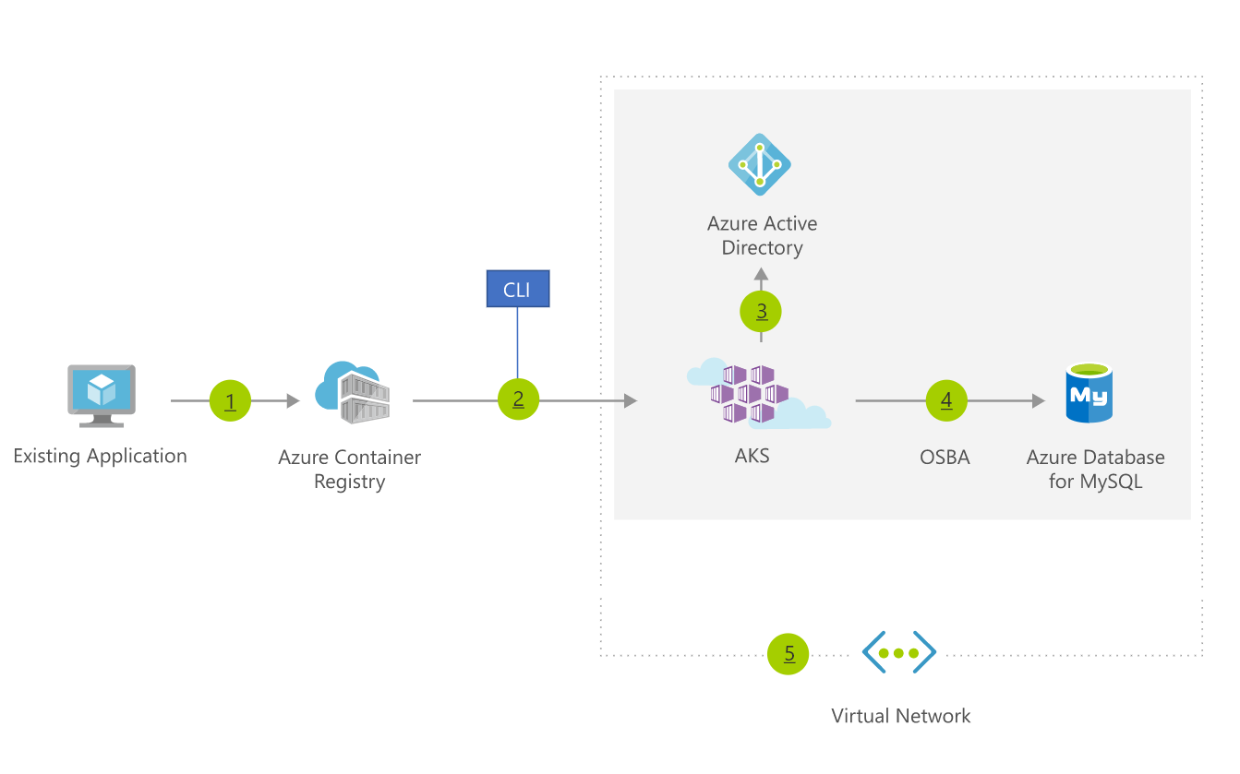
Use Case : Migrate an existing Application
Notes:
https://azure.microsoft.com/en-in/services/kubernetes-service/#solution-architectures

Slide 5
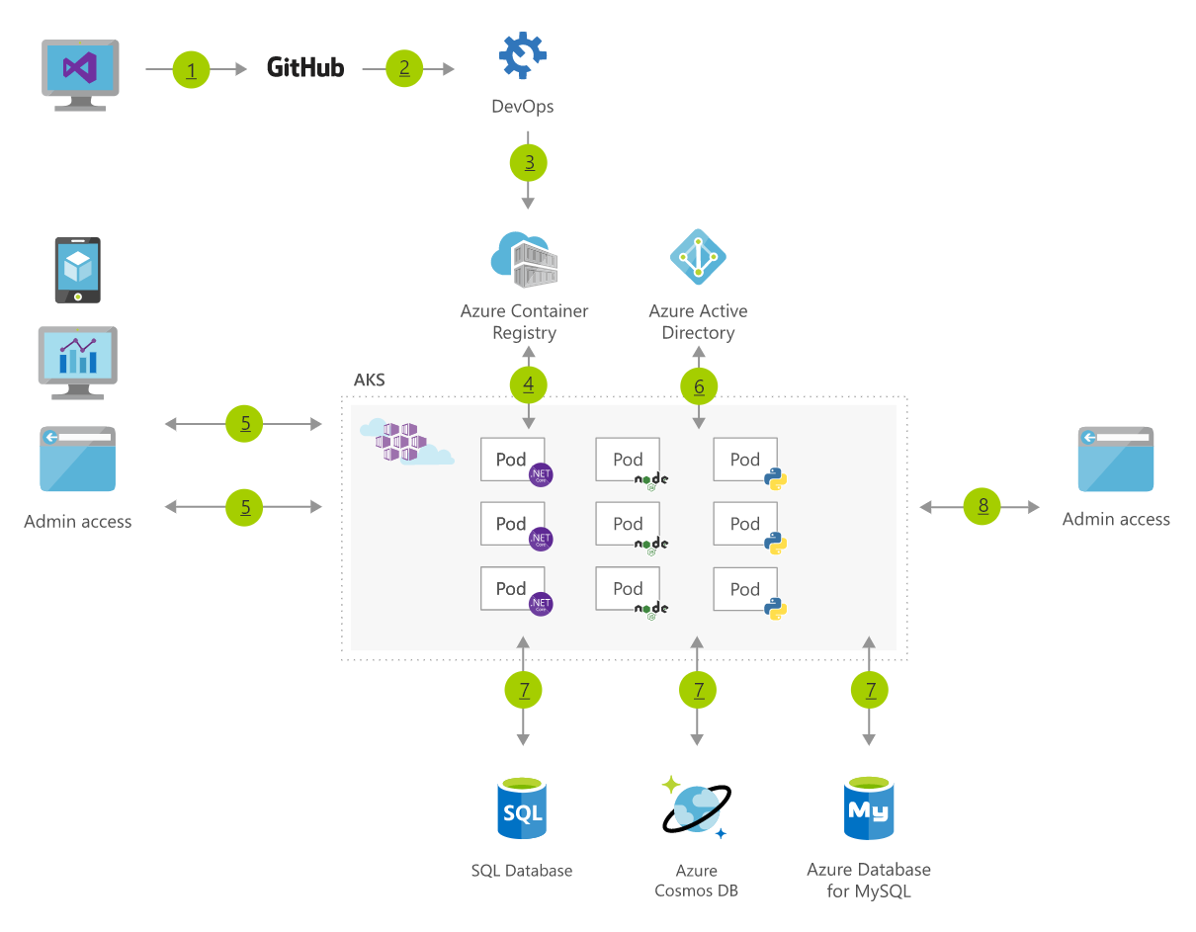
Use Case: Microservices Deployment

Slide 6
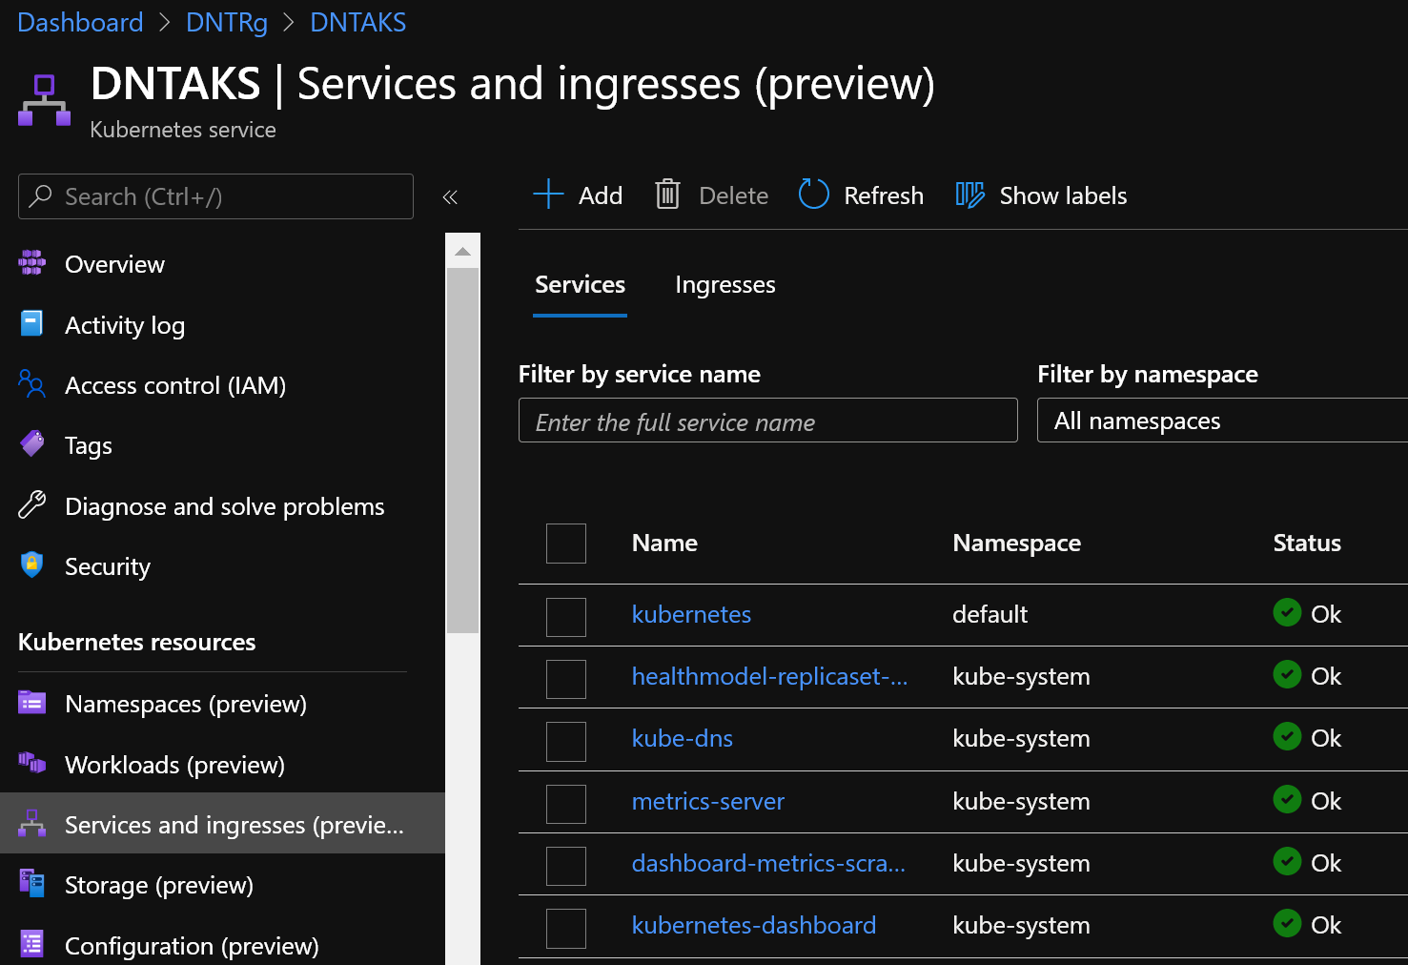
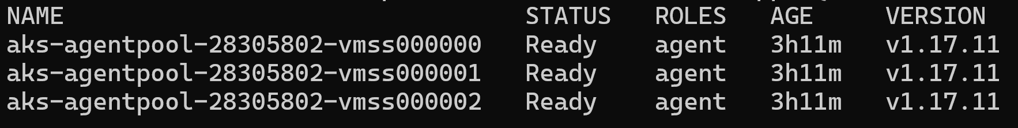
Accessing AKS Using CLI
> az aks install-cli
> az aks get-credentials -g <DNTRg> -n <DNTAKS>
> kubectl get nodes

Slide 7
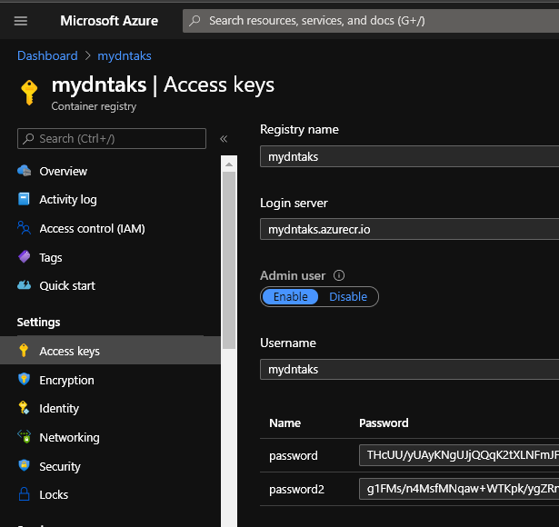
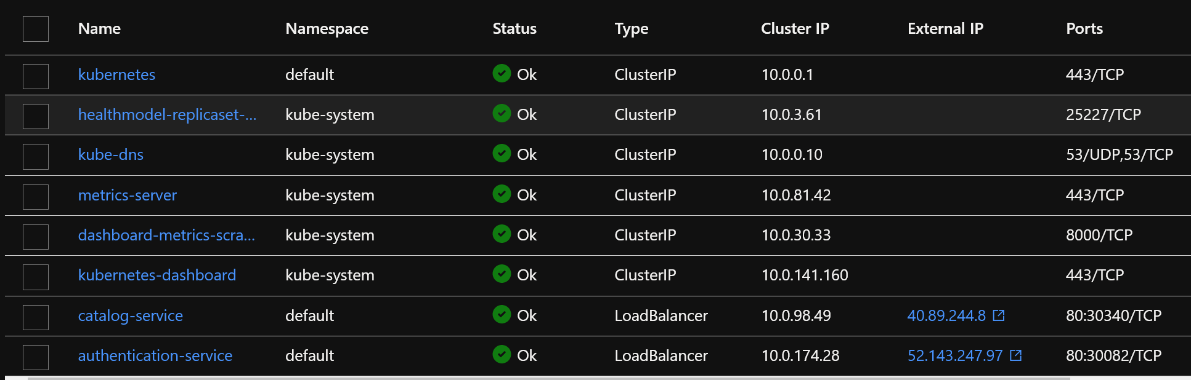
AKS Deployment Using CLI
> az acr login --name <registry-name>
> az account set -s <subsription_name_or_id>
>docker build -t catalog:v1 . -f ./CatalogService/Dockerfile
>docker tag catalog:v1 dntrepo.azurecr.io/catalogservice:v1
>docker push dntrepo.azurecr.io/catalogservice:v1
> kubectl create secret docker-registry <secret-name> --docker-server=<container-registry-name>.azurecr.io --docker-username=<acr-username> --docker-password=<acr-password>
> kubectl apply -f ./catalogservice catalog-deployment.yaml
Notes:
kubectl create secret docker-registry acr-secret1 --docker-server=mydntaks.azurecr.io --docker-username=mydntaks --docker-password=THcUU/yUAyKNgUJjQQqK2tXLNFmJFrXV
k8s Engine enables 3 types of ImagePullPolicy mentioned :
Always : It always pull the image in container irrespective of changes in the image
Never : It will never pull the new image on the container
IfNotPresent : It will pull the new image in cluster if the image is not present.

Slide 8
Steps For Deployment
Step1: Create Application Using ASP.NET Core.
Step2: Add Docker Support using Visual Studio.
Step3: Create ACR and Push Docker Images to ACR using VS.
Step4: Create AKS Cluster and Configure it to Access Locally.
Step5: Create Kubernetes Deployment Files.
Step6: Deploy Application to AKS using CLI.
Step7: Verify and Test Your Deployments.

Slide 9
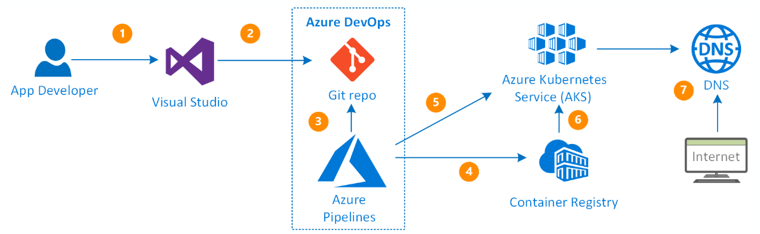
CI/CD Pipeline Using Azure DevOps and AKS
Notes:
https://medium.com/@prakashkumar0301/azure-devops-ci-cd-pipeline-with-aks-409fd2af52a0
https://docs.microsoft.com/en-us/azure/architecture/example-scenario/apps/devops-with-aks
https://www.azuredevopslabs.com/labs/vstsextend/kubernetes/

Slide 10
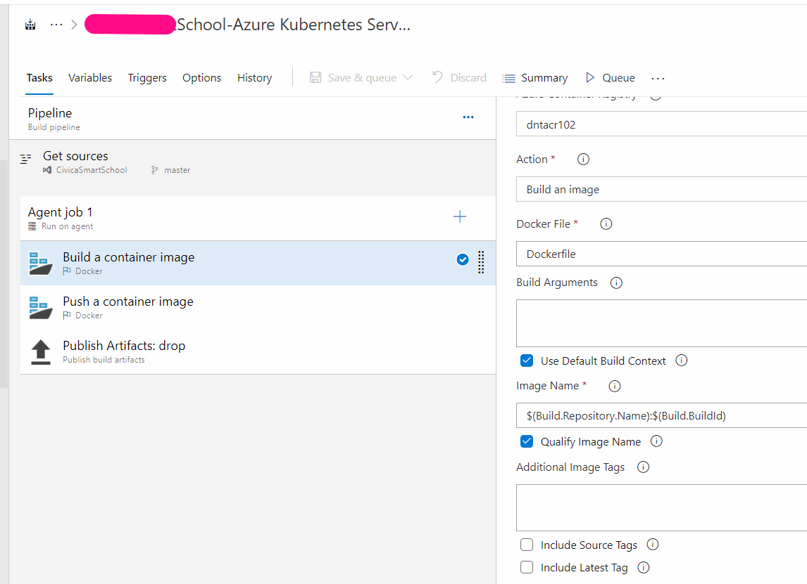
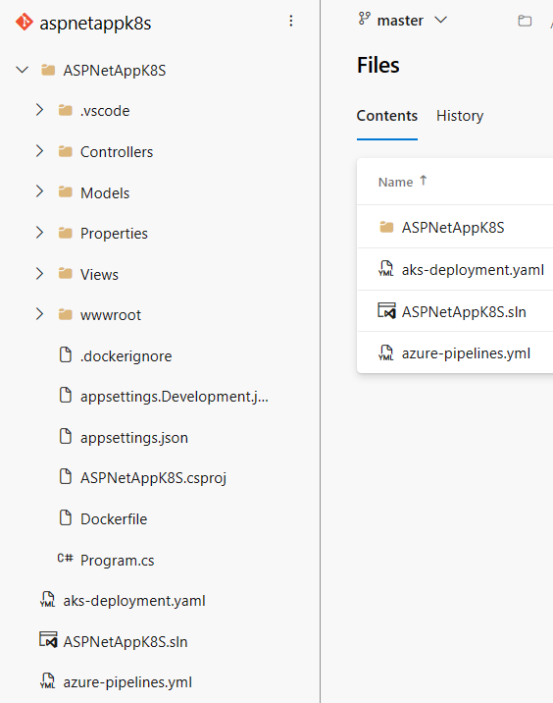
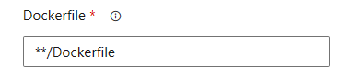
Building Image and Publish to ACR

Slide 11
Building Image and Publish to ACR
trigger:
- master
resources:
- repo: self
variables:
# Container registry service connection established during pipeline creation
dockerRegistryServiceConnection: '253899a3-f9ae-4b6f-91ab-7cefbf4cd834'
imageRepository: 'aspnetappks'
containerRegistry: 'shtk8s.azurecr.io'
dockerfilePath: '$(Build.SourcesDirectory)/ASPNetAppK8S/Dockerfile'
tag: '$(Build.BuildId)'
# Agent VM image name
vmImageName: 'ubuntu-latest'
stages:
- stage: Build
displayName: Build and push stage
jobs:
- job: Build
displayName: Build
pool:
vmImage: $(vmImageName)
steps:
- task: Docker@2
displayName: Build and push an image to container registry
inputs:
command: buildAndPush
repository: $(imageRepository)
dockerfile: $(dockerfilePath)
containerRegistry: $(dockerRegistryServiceConnection)
tags: |
$(tag)
- task: PublishBuildArtifacts@1
inputs:
PathtoPublish: 'aks-deployment.yaml'
ArtifactName: 'drop'
publishLocation: 'Container'
Notes:
Deploy to Azure Kubernetes Service with Azure Pipelines - Azure Kubernetes Service | Microsoft Learn

Slide 12
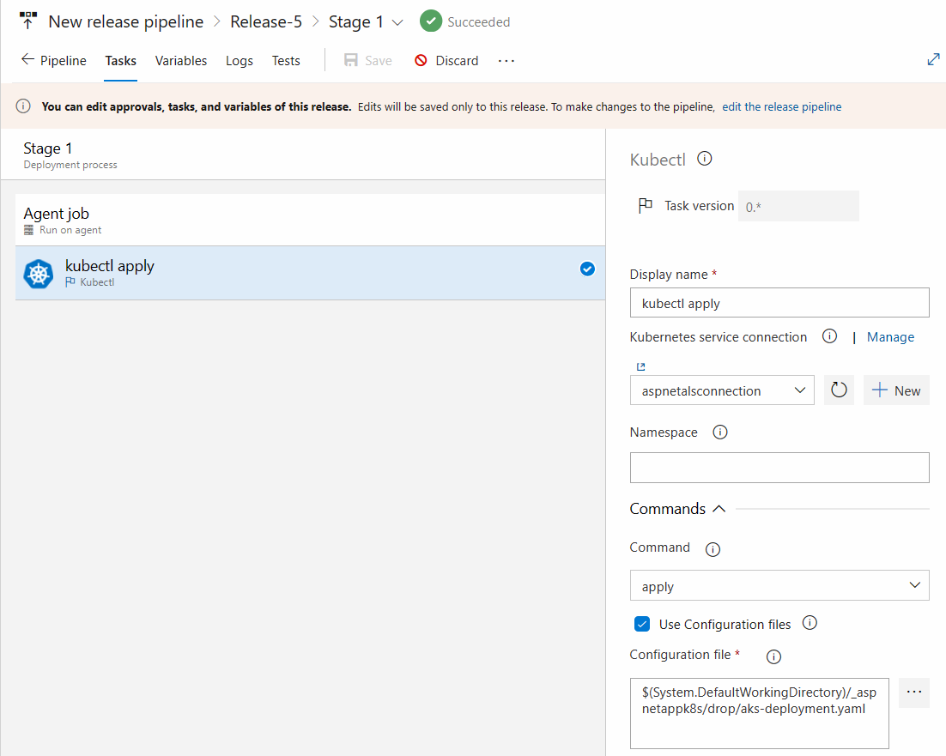
Release Pipeline: Publish to AKS

Slide 13
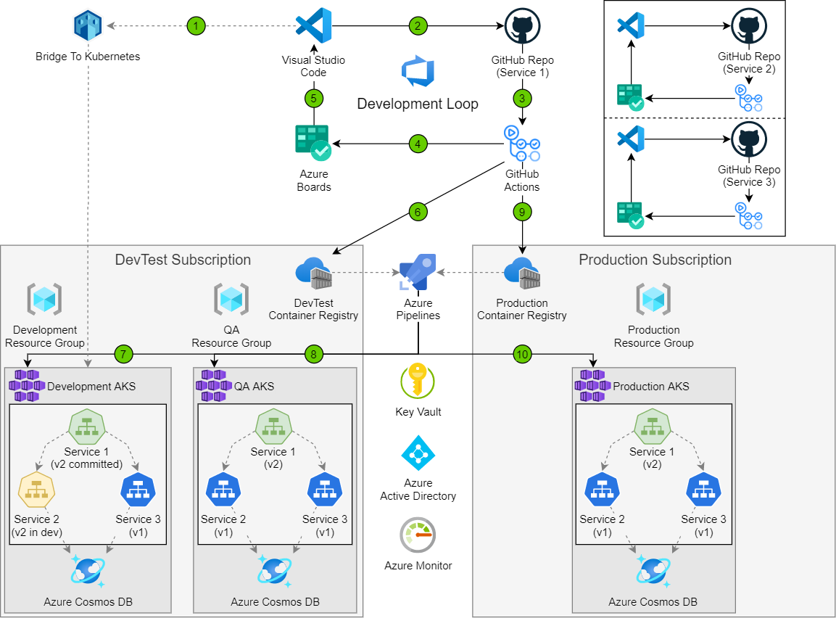
CI/CD Pipeline for Microservices
Notes:
https://docs.microsoft.com/en-us/azure/architecture/solution-ideas/articles/dev-test-microservice
steps:
task: Docker@2
displayName: Build docker
inputs:
command: 'buildAndPush'
Dockerfile: '**/Dockerfile'
buildContext: '$(Build.Repository.LocalPath)'
The dockerfile can stay as Visual Studio generated it.
Developers use Local Process with Kubernetes to run their local microservice versions within the context of the development Kubernetes cluster. Connecting to the cluster while debugging the service allows quick testing and development in the full application context.
Each microservice codebase uses a separate GitHub code repository for source control.
GitHub Actions builds the microservice container images and pushes them to Azure Container Registries. GitHub Actions also updates the latest tag of repositories for continuous integration (CI), or tags repositories for release.
GitHub Actions automated testing generates work items for Azure Boards, making all work items manageable in one place.
Visual Studio Code extensions support Azure Boards and GitHub integration. Associating Azure Boards work items with GitHub repos ties requirements to code, driving the development loop forward.
Commits merged into the integration branch trigger GitHub Actions builds and Docker pushes to the DevTest container registries. Each microservice has its own repository in Container Registries, paralleling the GitHub repositories. CI builds are usually tagged with latest, representing the most recent successful microservice builds.
Azure Pipelines runs the Kubernetes apply command to trigger deployment of the updated Container Registry images to the DevTest Kubernetes clusters. Azure can authenticate AKS to run unattended Container Registry pulls, simplifying the continuous deployment (CD) process.
Azure Pipelines uses Azure Key Vault to securely consume secrets like credentials and connection strings required for release and deployment configurations.
When a version of the application is ready for quality assurance (QA) testing, Azure Pipelines triggers a QA release. The pipeline tags all appropriate images with the next incremental version, updates the Kubernetes manifest to reflect the image tags, and runs the apply command. In this example, while a developer may be iterating on a service in isolation, only builds integrated via CI/CD are moved over to deployment.
After testing has approved a version of the service for deployment, GitHub Actions promotes a release from the DevTest Container Registry to a Production Container Registry. GitHub Actions tags the images with the appropriate version and pushes them into the Production Container Registry.
Azure Pipelines creates a release to Production. The pipeline imposes approval gates and pre-stage and post-stage conditions to protect the Production environment from inadvertent or incorrect deployment.

